Slide 1
Missing Middle Timeline
December 2019: - County Manager issues Missing Middle Study Framework
Study to “locate where new housing types are compatible with existing neighborhoods”
will “analyze locational factors” (eg transit, parking, environment)
“this is not an across- the -board rezoning of all single family homes”
Press Release: “Solutions need to be context-sensitive – not a one size fits all approach”
January 2020: - County publishes Missing Middle Housing Study
States staff will form “technical advisory group”
Instead, the County hires an economic consulting firm
Final Scope document “will include 1) analysis of locational factors, and 2) review of environmental impacts/ benefits
December 2021: - Staff releases MM Study Phase 1 Report
States “environmental, resource protection…should be incorporated in planning”
New housing supply “should be considered within the context of the County’s…transport network”
Civic Associations told to await Phase 2 study before taking a position

Slide 2
Subsequent Events (1)
April 28, 2022: Staff releases Phase 2 Analysis and Framework
If codified, will allow all types of MM housing on all single-family lots (affecting 75% of land in the County)
Effectively eliminates land use planning criteria (e.g. transit, parking, stormwater, green space) in determining suitability for increased density
Community engagement until May 27, Board to discuss Framework in July, final approval in September.
Community engagement at this time limited to Phase 2 study only

Slide 3
Subsequent Events (2)
May, 2022:
Civic Associations request a 4 month delay
Joint letter reiterates request for a delay
Questions rationale for across the board rezoning
Indicates we are compiling list of questions/concerns
County Board refuses the request for a delay
June 12 & 13: Civic Association Presidents meet with County Board
County website now indicates consultation until July 12
Target date for approval of zoning changes remains unchanged (September 2022)
Final decision on zoning changes may not take place until at least 30 days after the changes are published
Some Board members are open to extending these dates to November or perhaps early 2023.

Slide 4
Proposed Zoning Amendments
June 2022

Slide 5
The Staff Proposal
Amend zoning rules to allow townhomes and buildings with 2-8 units in all districts currently limited to single-household development. (R-5 to R-20 zones).
Townhomes would be limited to groups of three.
Developments would be by right. There would be no site plan approval needed.
Structures would be held to the same design standards as required for single household development (height, setbacks, lot coverage)
Parking requirements would fall from one to one-half spaces per unit.
Minimum tree canopy requirements would be 10% or 15%, they now are 20% for single detached. (The amendments may lower the single detached minimum.)
Notes:
Thus while under current rules an 8 plex would have to provide 8 parking spaces under these rules only 4 would be required.
Tree canopy requirements are set by the state law, which is why they differ.

Slide 6
Estimated Results of Proposal
The county retained Partners for Economic Solutions (PES) to estimate the effects of these changes.
PES estimated that from 160 to 190 lots would be redeveloped annually in Arlington. (Table A-7)
Only 19 to 21 of those lots would be missing middle developments, in the view of PES. The rest would be single-family homes. (Table A-7)
The PES estimate is controversial. Many believe that it is an underestimate. An alternative estimate is 154 missing middle developments.

Slide 7
Estimated Results of Proposal
Because PES estimates that very few missing middle developments would be built, its estimate of the effect of the zoning changes on population and school enrollment is limited.
Net increase in school enrollment estimated to be 9 - 13 students per year, 90 to 130 in ten years.
Net increase in county population will be 150 people per year, 1,500 people in ten years.
These increases are in addition to increases in County population that would take place for other reasons, such as additional large apartment buildings.
If the critics of PES are correct and its estimates of the amount of missing middle housing are too low, then the estimated increase in school enrollment and county population are likely also too low.

Slide 8
What Housing Would be Built?
PES indicates 83% of the units in the additional missing middle housing would be in buildings with 6 or 8 units.
13% would be in duplexes. 4% would be in fourplexes
Most of these units, 72% to 74%, would be more than a half mile from Metro.
Notes:
Source: PES Table A-8.

Slide 9
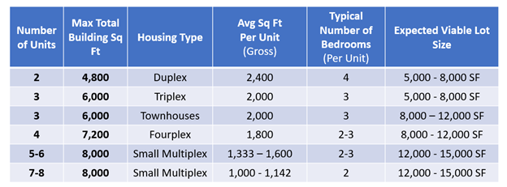
What Housing Would be Built?
The table from County staff indicates the size of the units in the various types of missing middle housing:
Notes:
Source: County staff responses to questions (response matrix).

Slide 10
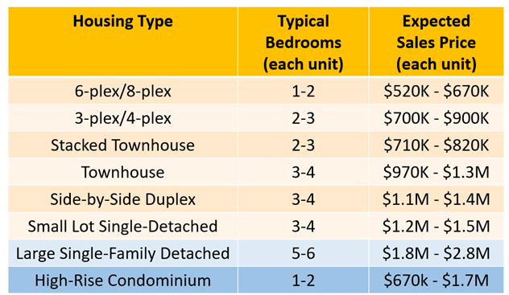
Cost of MM Housing
Expected selling prices of the missing middle housing are below.
Notes:
Note units may be sold or rented

Slide 11
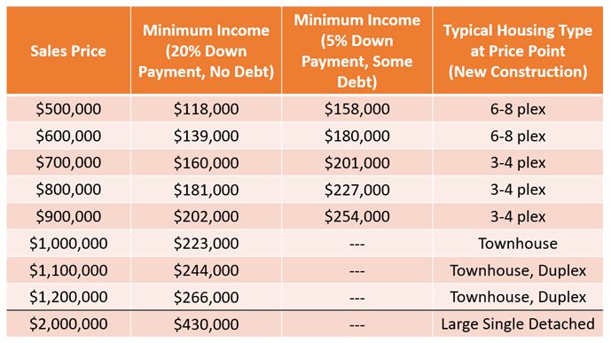
What Housing Would be Built?
What someone can afford to buy depends on factors such as down payment and other debt. Below are some illustrative calculations.
Notes:
Source: County staff responses to questions (response matrix).
Note from Diane: At this moment in the MLS, there are 65 homes on the market with 3 to 5 bedrooms with prices ranging from $499,000 to $1 million. That includes 37 single family homes, 6 duplexes, 22 townhouses.

Slide 12
ARLINGTON COUNTY MISSING MIDDLE STUDY
Goals/purpose/rationale and
confusion & questions

Slide 13
Stated Purpose Of Missing Middle
DEC 2019 REPORT
PURPOSE
the purpose of the Missing Middle Study is to examine how new housing types and forms could be introduced in Arlington that broaden the range and supply of housing
OUTCOMES
policy options to support preservation of existing Missing Middle housing stock and production of new Missing Middle housing types for County Board consideration
the ability for new housing type alternatives to be built that meet Arlington’s definition of “missing middle housing”, offering greater affordability and design that is complementary and compatible with the scale and style of their intended neighborhoods

Slide 14
(Report, DEC. 2019)
KEY CONSIDERATIONS ( excerpt)
assessment of the economic feasibility of constructing new types of missing middle housing and the probable affordability level(s)
analysis of locational factors, such as access to multi-modal transportation options; proximity to major arterials; proximity to jobs, shopping and recreational opportunities; areas of environmental sensitivity
study of the compatibility of potential new housing types with adjacent uses and activities in terms of height, massing, and architecture;
valuation of impacts and benefits to the environment and public realm, including natural resources, storm water management, energy, parks and open space, and on-street parking;
examination of how to mitigate and/or lessen the potential impacts on neighboring properties with attention to tree loss/replacement and storm water management
SOURCE: https://arlingtonva.s3.amazonaws.com/wp-content/uploads/sites/15/2019/12/HousingArlington_MissingMiddleHousingStudy_Framework.pdf

Slide 15
Study scope and timeline, Sept. 2020
RATIONALE
Land use policy and zoning decisions made in the past, without intentional policy updates over time, have contributed to racial disparities in housing and access to opportunity. Many areas of Arlington zoned primarily for single-family detached housing overlap with census tracts where 70% or more of the population is white.
Arlington’s exclusionary zoning and land use policy does not support diversity of households, especially Black or African American and Hispanic or Latino households.
If Arlington does nothing,… Arlington’s vision to be a diverse and inclusive community will become less attainable.
Given these market realities, the current exclusive nature of Arlington’s land use policy and zoning framework,… and the impacts of these barriers on housing diversity and supply in Arlington, the study will consider what types of housing could bridge the missing middle housing gap…
…address the racist elements of our systems and institutions, work to address the land use policies and zoning regulations that create barriers and exclusions
SOURCE: https://arlingtonva.s3.amazonaws.com/wp-content/uploads/sites/15/2020/09/MM-Scope-Charge-and-Timeline_Final-September-2020.pdf

Slide 16
Phase 1 Report, Jan. 27, 2021
PHASE ONE JAN 2021 REPORT
GOALS
“Missing Middle could provide an incentive for better development
Broader range of housing options (size, price, type)
Meet sustainability goals (trees, stormwater)
Better distribution of different housing types throughout the County”
SOURCE (JAN. 2021): https://www.arlingtonva.us/files/sharedassets/public/Housing/Documents/Regional-Mtg-Presentation-1-27-21.pdf

Slide 17
Phase 1 Report, Nov. 2021
The Missing Middle Housing Study will focus on increasing housing supply and housing choice as a land use tool to meet Arlington’s housing needs
The study is not intended to create “affordable housing,” which is typically restricted to households earning less than 60% of the area median income ($69,660 for a three-person household) for rental or 80% of the area median income ($92,880 for a three-person household) for ownership
The study will explore how to make it easier to build more of the MM housing that is already allowed, enable housing types not currently allowed
https://www.arlingtonva.us/files/sharedassets/public/housing/documents/missing-middle/mmhs_phase-1-report-final-draft.pdf

Slide 18
(PHASE 1 REPORT, Nov. 2021)
HIGHLIGHTS
“…do not always correlate with a specific income bracket but can be less expensive than other housing options..”
Cost varies based on style, size, location, and market forces
SOURCE: https://www.arlingtonva.us/Government/Programs/Housing/Housing-Arlington/Tools/Missing-Middle/Phase-1

Slide 19
Phase 2 analysis & draft Framework
(APRIL 28…FIRST TIME RESIDENTS & CIVIC ASSOCIATIONS SAW FRAMEWORK DETAILS)
FRAMEWORK GOALS: Increase supply, diversify housing types
FRAMEWORK OBJECTIVES: More options for more people at more income levels and more stages of life distributed throughout Arlington; more equitable housing options
Could be renter- or owner-occupied

Slide 20
Framework concerns, ongoing questions
WHERE CAN MM BE BUILT?
Framework changed from earlier, published expectations; by-right construction of multiplexes may occur in any lot
Want to fully understand what that could look like and where
HOW WILL STORMWATER BE MANAGED?
“Stormwater runoff would be comparable to current impacts from single detached redevelopment”
WILL MM BE AFFORDABLE TO MIDDLE INCOME?
Market to set pricing; MM about “form”

Slide 21
(cont’d)
IS PARKING SUFFICIENT?
Some see environmental benefits; others concerned about overflow through neighborhoods
WHAT ABOUT KEEPING MODEST, SMALLER HOMES?
Framework silent
HOW MUCH HOUSING EXISTS NOW IN $500k-$1m RANGE?
Through independent consultations with realtors, CAs learned that MM homes are routinely available

Slide 22
(cont’d)
CAN CA’S HAVE MORE TIME TO GET MEMBERS’ INPUT?
BCA + other CAs have NC Plans
Being “a residential neighborhood of primarily detached homes”
Cannot simply dismiss NCPs; must consult with members
14 associations met with Board to express concerns and ask for time
READ THE FRAMEWORK: https://www.arlingtonva.us/files/sharedassets/public/housing/documents/missing-middle/mmhs-phase-2-public-presentation_05.02.pdf

Slide 23
BCA advocating for smart policy & process
BCA has supported multiplexes in targeted locations for decades
BCA advocating for time/process allowing significant resident feedback
Not clear if time for CA processes
BCA members may provide directly to County through its processes
Members may have other ideas about meeting needs of middle income housing
BCA advocating that the County addresses stormwater
Now, a serious threat to homes; should carefully and thoroughly address in MM plan
BCA advocating that county develop thoughtful policy
BCA has asked the County Board to consider concerns, questions before all zoning in Arlington changes irrevocably

Slide 24
Next Steps
County Board & County staff work session on Missing Middle is scheduled for July 12
Early fall County staff is expected to release the Phase 3 report.
Phase 3 report will propose amendments to the Zoning Ordinance, Comprehensive Plan and other policies and work programs to implement Missing Middle recommendations.
County Board action on the Phase 3 proposals is currently anticipated to occur by the end of 2022. Expected meeting dates are November 12 and December 17.
Public hearings by the Planning Commission to proceed County Board meeting. Expected hearing dates are November 2 and December 5.

Slide 25
County Missing Middle Staff Contacts
Missing Middle Study Project Manager : Richard Tucker rtucker@arlingtonva.us
Missing Middle Public Engagement Manager : Elise Cleva ecleva@arlingtonva.us
Planning Commission Coordinator: Courtney Badger cbadger@arlingtonva.us
Call 703 228-0770 to sign-up to speak at Planning Commission meetings

Slide 26
Questions?

